Slide 1

Covid – 19 Impact : City of San Antonio/ Bexar County
Contributors:
Uma Yeruva,
Samantha Brown,
Ahmed Dahham & Julia Lira

Slide 2



Johns Hopkins Corona Virus Resource API was utilized to find information ranging from age, race, case count, vaccine types, vaccine rates, testing rates and hospital info. This information was extracted into CSV files and sorted for one state – Texas for the date range of January 20 , 2021 to current Additional resources referenced include Texas Health and Human Services and City of San Antonio

Slide 3
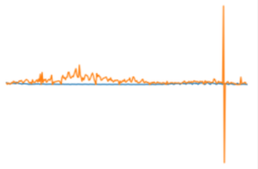
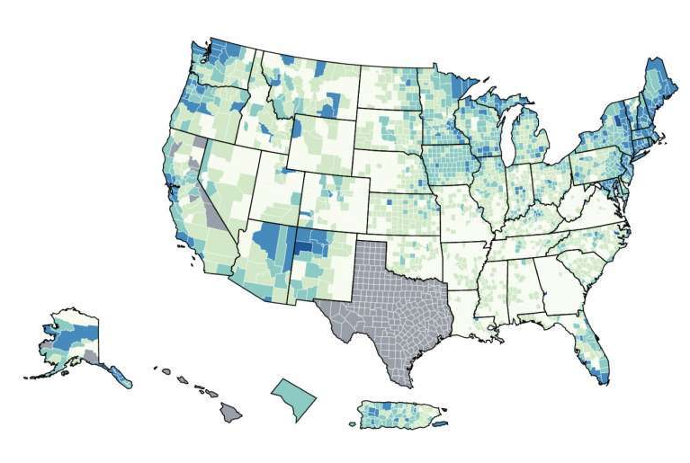
Limitations Sept 27 & 28 data incorrect In John Hopkins Daily Confirmed cases - line chart exposed negative #s Inconsistent data capture in San Antonio site – some included dates but not counties and vice versa. Houston Chronicle article from June referenced a CDC map that reflected missing data that resulted from state mandates on reporting

Slide 4

Questions to address with data gathered:
Relationship of population to Vaccination Rate
Bexar county Vaccination rate
( Single dose vs Fully Vaccinated)
3. Comparison of Fully Vaccinated vs Single Dose
by:
Age
Gender
Ethnicity
5. Limitations

Slide 5

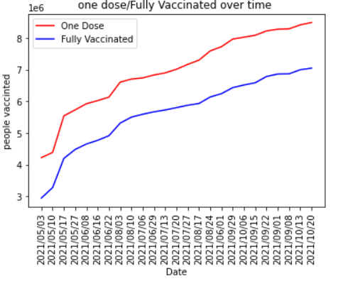
Bexar County Vaccinations One Dose vs Fully Vaccinated (Timeframe : May 3,2021 – Oct 10, 2021)

Slide 6
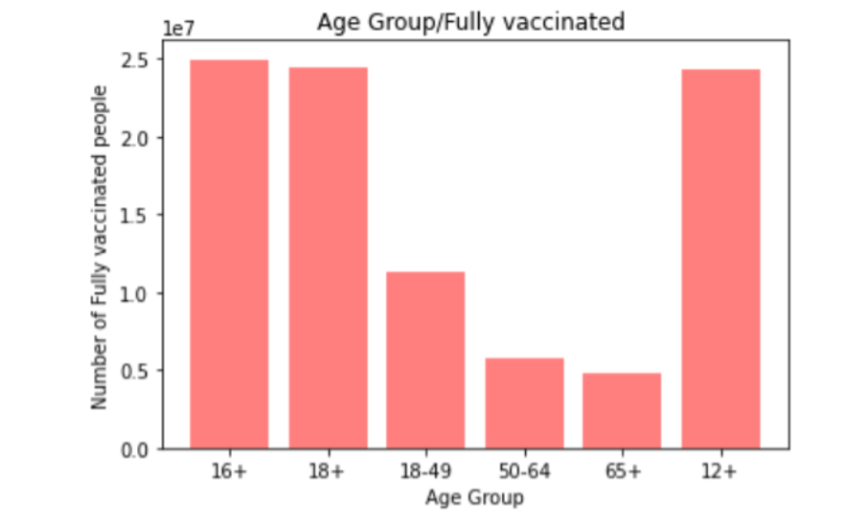
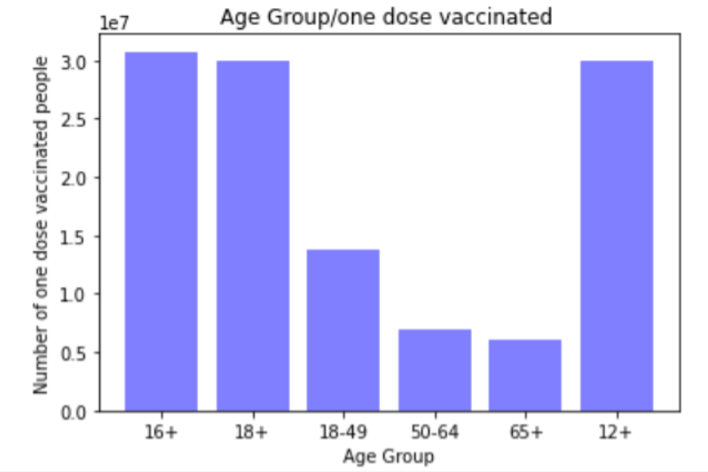
Comparisons: Age
Relationship of Age correlation to Fully Vaccinated vs Single Dose

Slide 7
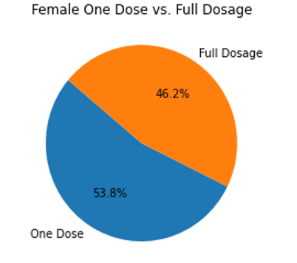
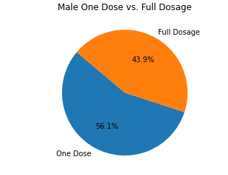
Comparisons: Gender
Relationship of Gender
Vaccinated vs Single Dose

Slide 8
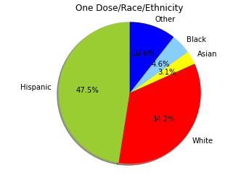
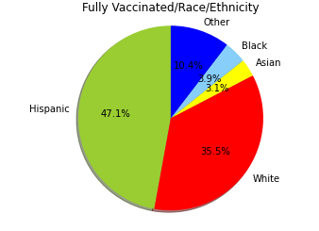
Comparisons: Race / Ethnicity
Relationship of Race / Ethnicity
Fully Vaccinated vs Single Dose

Slide 9
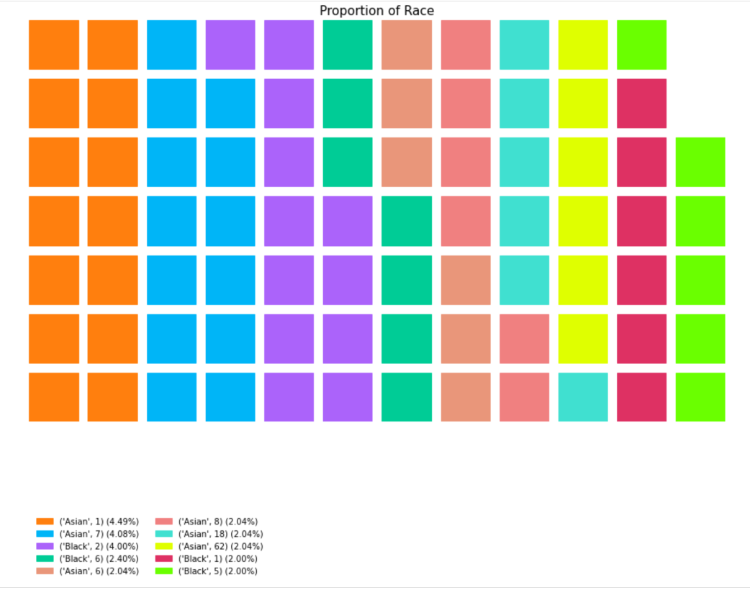

Slide 10
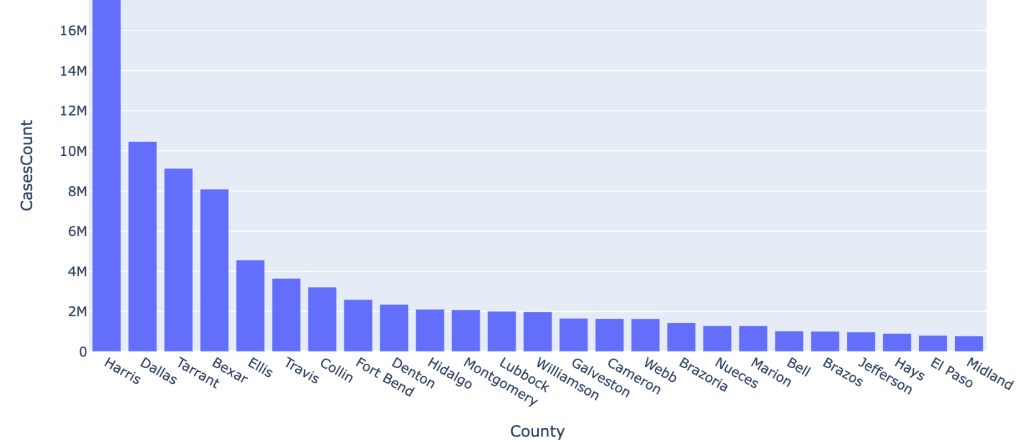
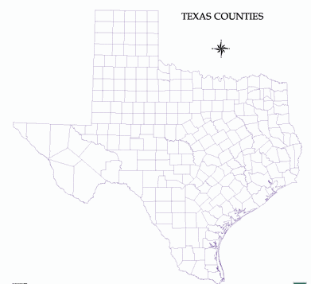
Other TX counties by comparison ( top 5 vs bottom 5 counties vaccinated )

Slide 11
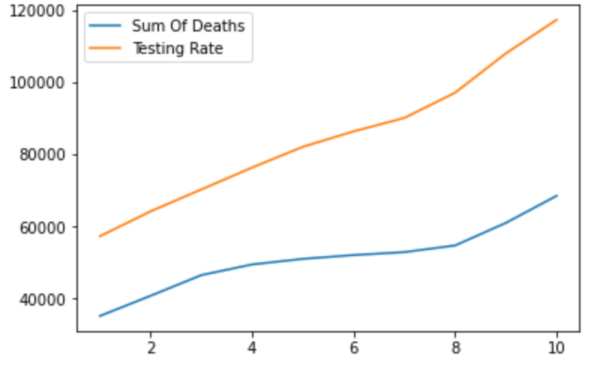
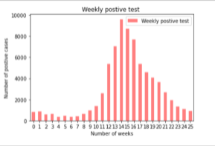
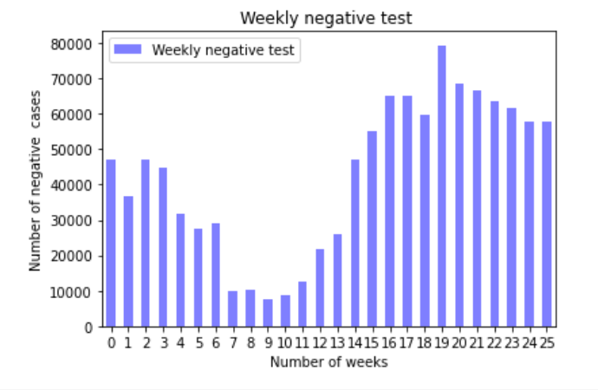
Correlation & Conclusion Direct correlation shows vaccination increase lead to lowering of cases

